Slide 1
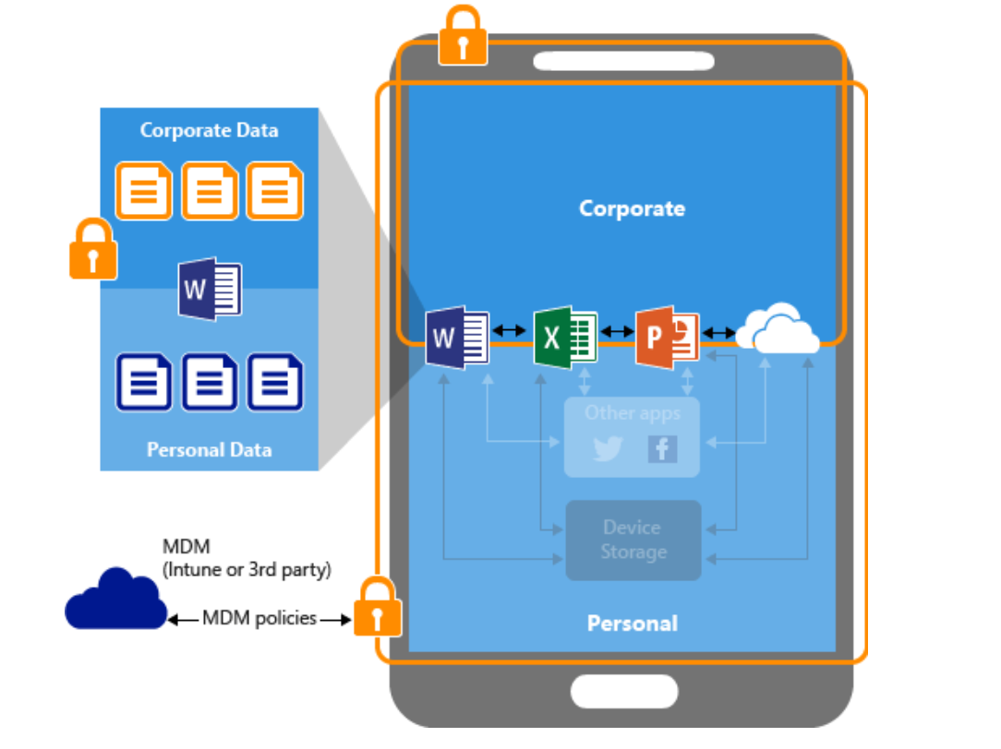
Security considerations in Exchange and SharePoint Online. Mobile Device Management
Module 4
SoftUni Team
Technical Trainers
Software University
http://softuni.bg

Slide 2
Questions
sli.do # SaaS-Security

Slide 3
Table of Contents
Security considerations in Exchange Online and SharePoint Online
Office 365 Advanced Threat Protection
Using Microsoft Intune as MDM
Demonstration

Slide 4
Security considerations in Exchange Online and SharePoint Online

Slide 5
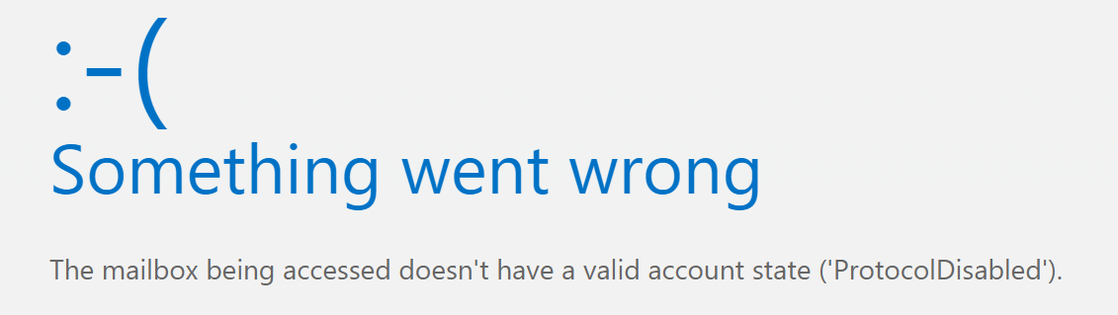
Exchange Online – restricting mailbox access
Mailbox access settings
ActiveSync
OWA for Devices
Outlook on the web
IMAP
POP3
MAPI

Slide 6
Client access rules in Exchange Online
You can control access to your Exchange Online organization based on client properties or client access requests
Some examples:
Allow Exchange ActiveSync clients from specific IP addresses and block all other ActiveSync clients
Block access to Exchange Web Services (EWS) for users in specific departments, cities or countries
Block access to the Exchange admin center (EAC) for users in a specific country or region
Configuration only available in Exchange Online PowerShell (not discussed in this course)

Slide 7
Basic vs modern authentication
Basic authentication:
Is used in older Outlook versions (before 2013)
uses simple HTTP login methods, rather than more complex OAuth-based authentication mechanisms
Enabled by default in Office 365
Modern authentication:
Support for MFA (Multi-factor authentication)
Better protection from brute force and password spray attacks
Enabled by default in Office 365

Slide 8
Email encryption in Exchange Online
Three email encryption options in Office 365:
Office 365 Message Encryption (OME)
Information Right Management (IRM)
Secure/Multipurpose Internet Mail Extensions (S/MIME)

Slide 9
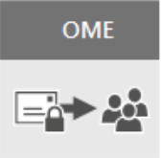
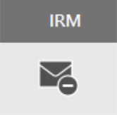
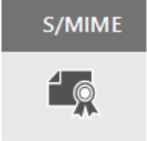
Compare email encryption in Exchange Online
Built on Azure RMS (Rights Management Services)
Use Azure RMS templates to:
Only encrypt
Do not forward
Company protect
No additional setup required
Can configure Exchange Online IRM to use on-premises AD RMS
Not very common
Well known protocol
Used for encryption and signing
Requires certificates and publishing infrastructure
You must have the public keys for each recipient

Slide 10
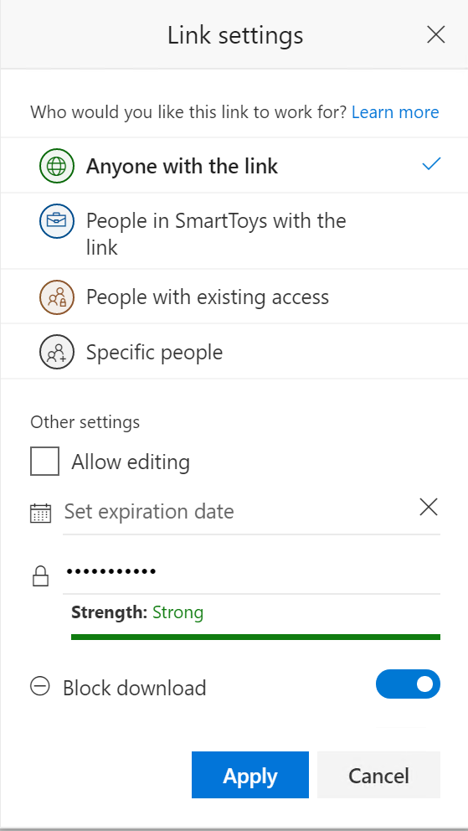
SharePoint Online – anonymous links
Sharing with “anonymous link” may dramatically lower the security since the link can be forwarded to anyone
If possible, minimize the risk by:
Permit read-only access
Set expiration date
Provide password
Block download

Slide 11
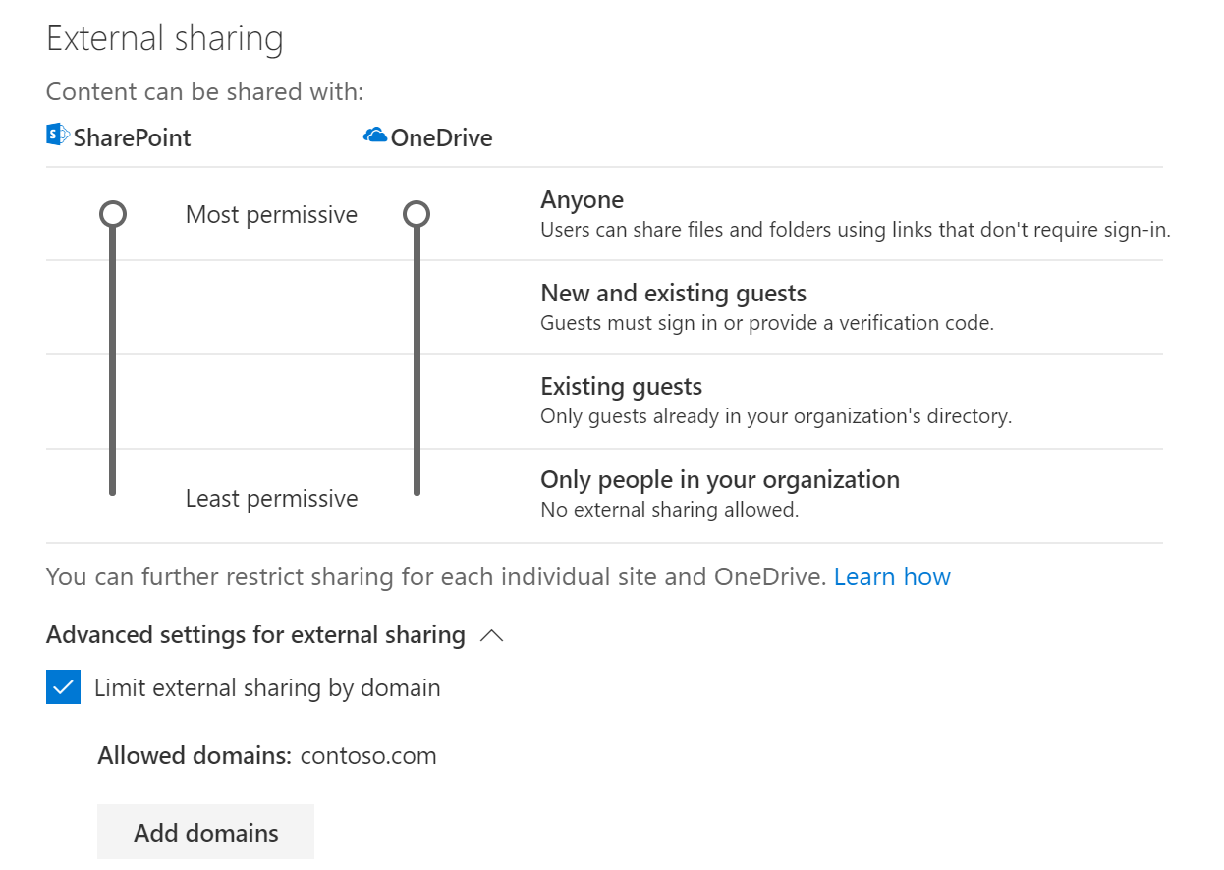
SharePoint Online – limit sharing by domain
Remember, external sharing settings are on two places:
At the organizational level
At the site level
Some additional options to secure external sharing at the organizational level exist
One of them is to limit sharing by domain

Slide 12
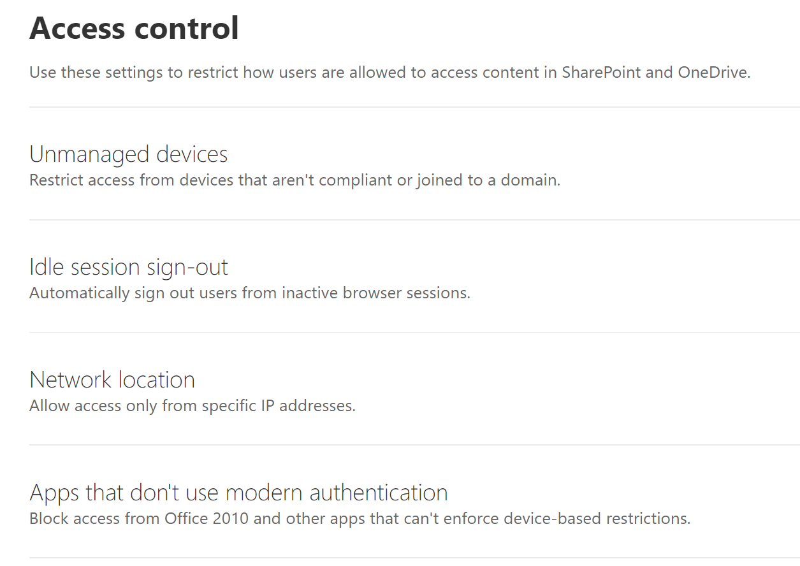
Access control in SharePoint Online
Additional security in SharePoint Online allows you to:
Control the behavior of uncompliant or not domain joined devices
Auto sign-out inactive users
Control access based on network (IP) location
Allow or block access from apps which do not support modern authentication

Slide 13
Questions
sli.do # SaaS-Security

Slide 14
Office 365 Advanced Threat Protection (ATP)

Slide 15
What is Office 365 ATP
Office 365 ATP capabilities:
Safe attachments
Safe links
Anti-phishing policies
ATP for SharePoint, OneDrive and Teams
Office 365 attack simulator
More…

Slide 16
What is Office 365 ATP (2)
Office 365 ATP is part of Microsoft Threat Protection
ATP Plan 1 vs ATP Plan 2
ATP is included in Office 365 Enterprise E5, Office 365 Education A5, and Microsoft 365 Business

Slide 17
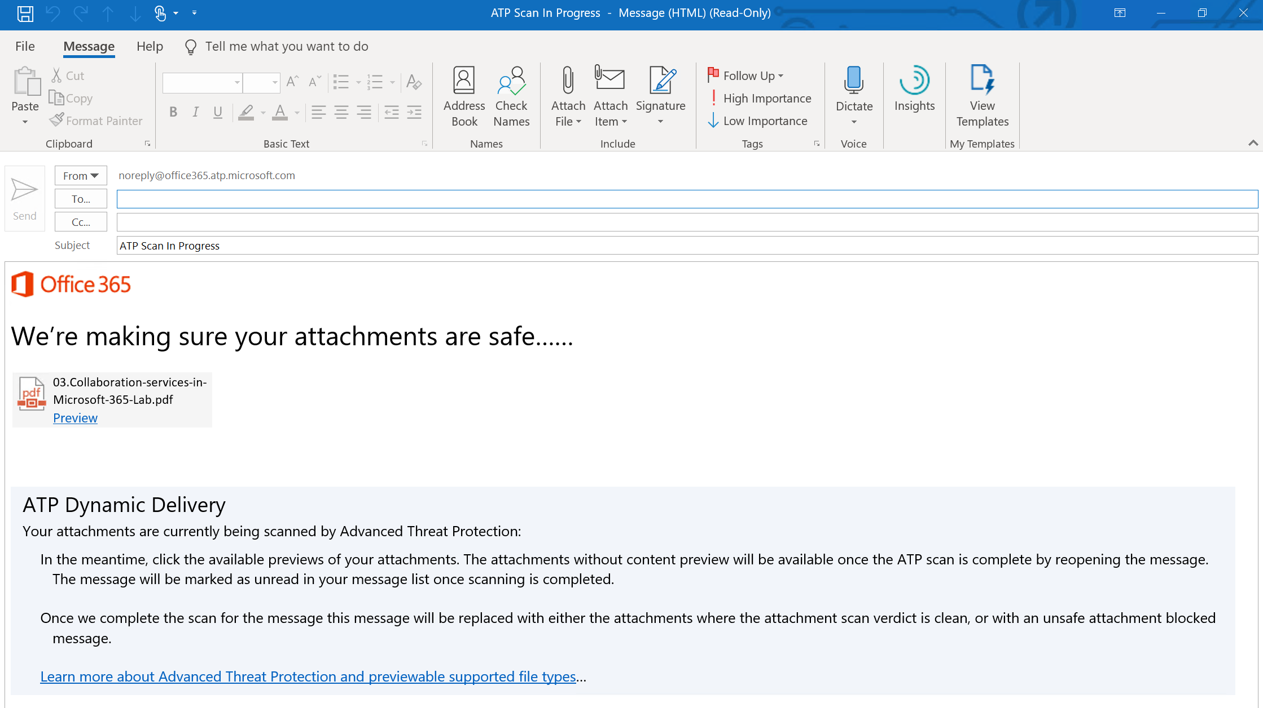
Safe attachments

Slide 18
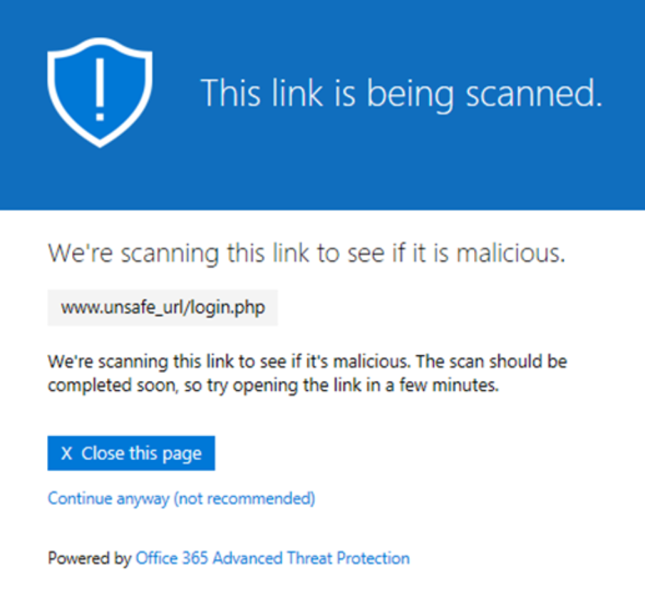
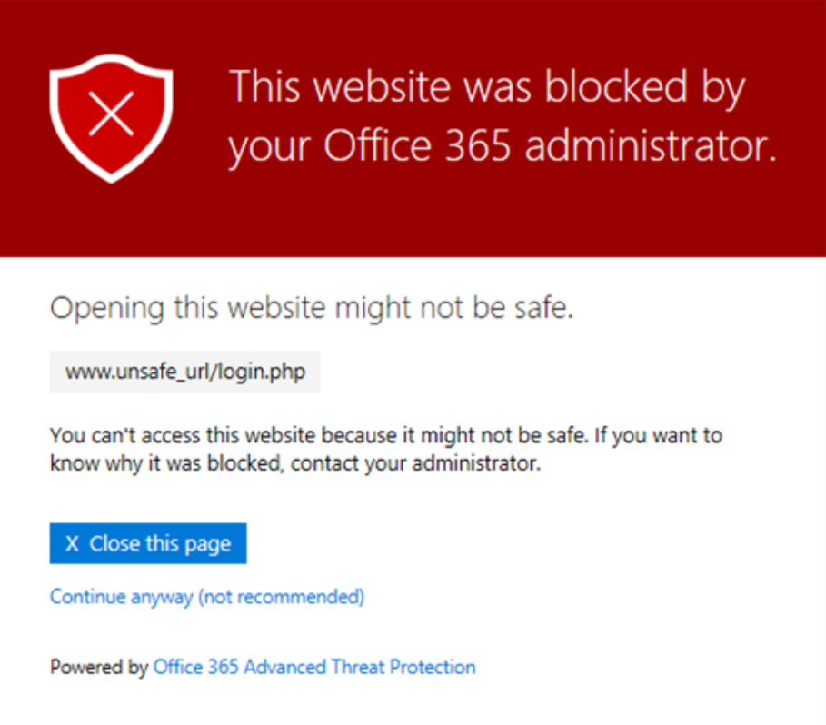
Safe links

Slide 19
Questions
sli.do # SaaS-Security

Slide 20
Using Microsoft Intune as MDM

Slide 21

Security vs usability
Usability
Security

Slide 22



Mobility is the new normal
52%
90%
>80%
52 percent of information workers across 17 countries report using three or more devices for work*
90 percent of enterprises will have two or more mobile operating systems to support in 2017**
>80 percent of employees admit to using non-approved software-as-a-service (SaaS) applications in their jobs***
* Forrester Research: “BT Futures Report: Info workers will erase boundary between enterprise & consumer technologies,” Feb. 21, 2013
** Gartner Source: Press Release, Oct. 25, 2012, http://www.gartner.com/newsroom/id/2213115
*** http://www.computing.co.uk/ctg/news/2321750/more-than-80-per-cent-of-employees-use-non-approved-saas-apps-report

Slide 23







User vs IT
User
Devices
Apps
Data
IT

Slide 24

Full lifecycle management
Enroll
Provide a self-service Company Portal for users to enroll devices
Deliver custom terms and conditions at enrollment
Bulk enroll devices using Apple Configurator or service account
Restrict access to Exchange email if a device is not enrolled
Provision
Deploy certificates, email, VPN, and WiFi profiles
Deploy device security policy settings
Install mandatory apps
Deploy app restriction policies
Deploy data protection policies
User
IT
Retire
Revoke access to corporate resources
Perform selective wipe
Audit lost and stolen devices
Manage and Protect
Restrict access to corporate resources if policies are violated (e.g., jailbroken device)
Protect corporate data by restricting actions such as copy, cut, paste, and save as between Intune-managed apps and personal apps
Report on device and app compliance

Slide 25
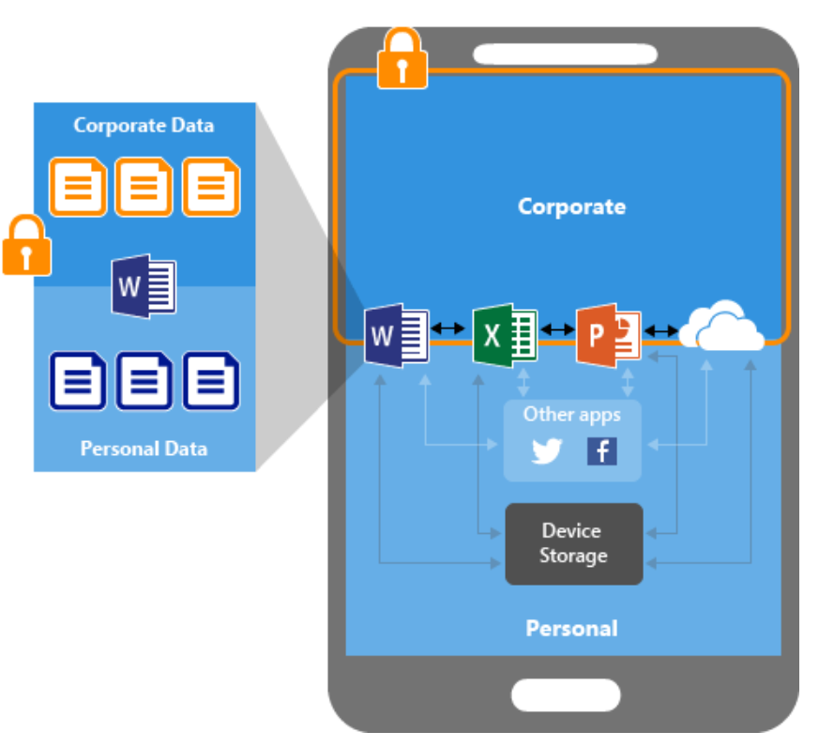
Mobile Application Management (MAM)
Known as “App protection policies”
Protecting your company data at the app level
End-user productivity isn't affected – policies do not apply for the same app if the data is personal
App-layer protection examples:
Require PIN to open an app
Control sharing of data between apps
Prevent saving to personal storage/location

Slide 26
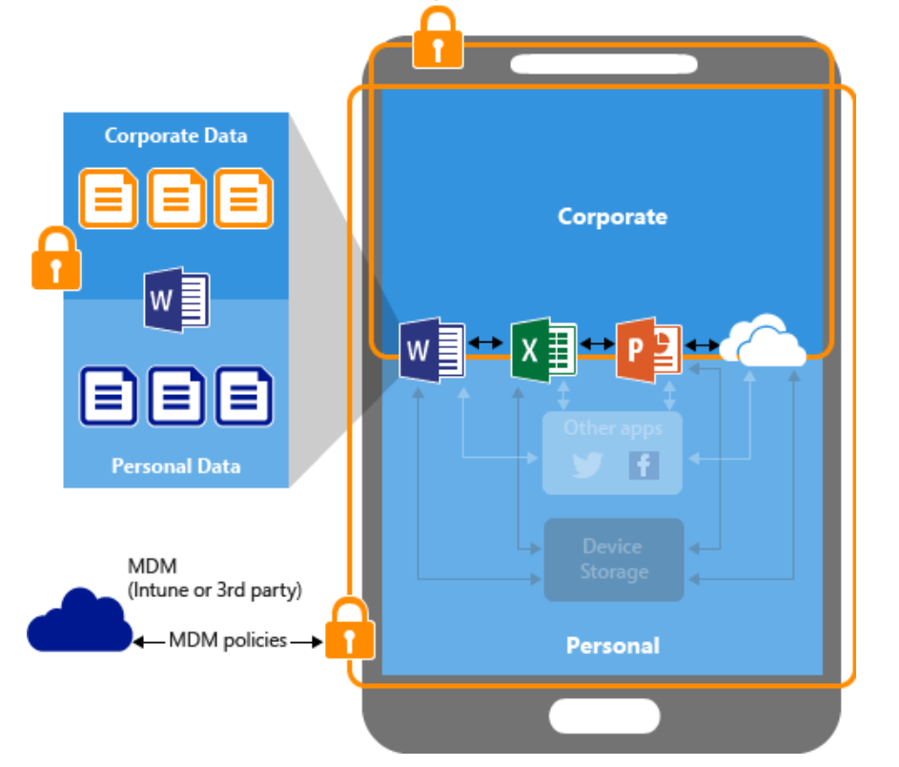
Mobile Device Management (MDM)
Additional level of security – the whole device is now protected
Device-layer protection examples:
Require PIN to access the device
Deploy apps to the device
Restrict camera usage
Remote wipe
The device must be enrolled in Intune
In this picture, we have MDM + MAM protection

Slide 27
Which client app?
In BYOD (bring your own device) scenarios, the enrollment process is initiated by the user
When trying to access the corporate email, users may want to use other (than Outlook) client apps:
Android: Gmail (or something else)
iOS: Mail (or something else)
How do we protect the app (and the device) in this situation?

Slide 28
Conditional access
With conditional access policies we can enforce the user to use an “approved” client app
The logic is:
IF you want to use the corporate email, THEN you must use Microsoft Outlook
Microsoft Outlook is an approved app, which is subject to app protection policies
This is how we enforce MAM

Slide 29
Conditional access (2)
With conditional access policies we can enforce the user to use an “approved” client app and the device to be enrolled in Microsoft Intune
The logic is:
IF you want to use the corporate email, THEN you must use Microsoft Outlook and make your device managed
Microsoft Outlook is an approved app, which is subject to app protection policies
This is how we enforce MAM and MDM

Slide 30
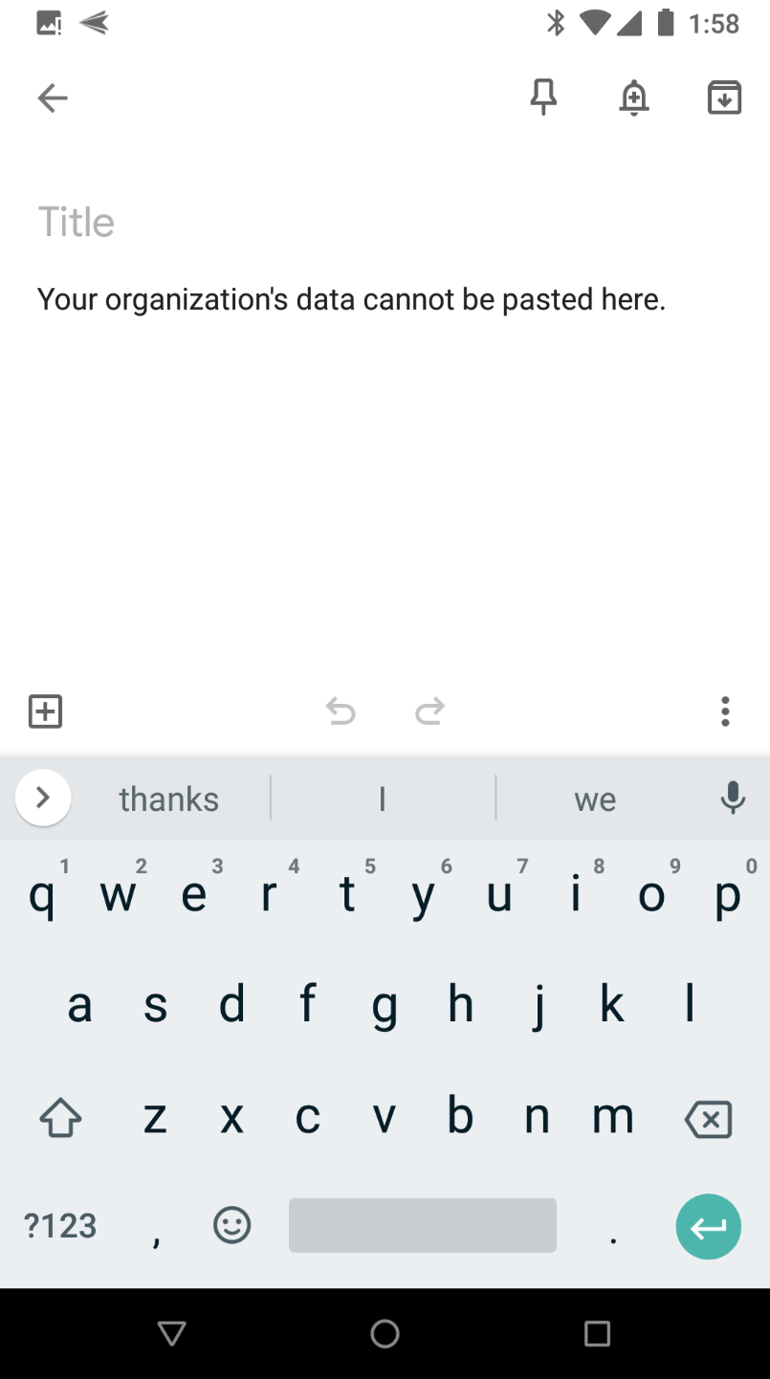
The result: restricted paste
You can restrict copy and paste between policy managed and “external” apps
Result from app protection policy (MAM)

Slide 31
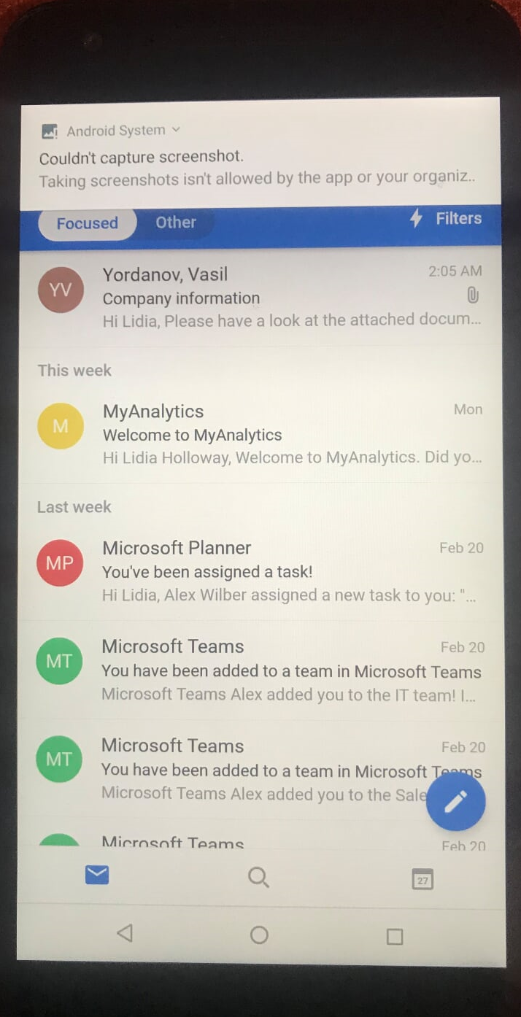
The result: restricted screenshots
You can restrict making screenshots while inside an app
Result from app protection policy (MAM)

Slide 32
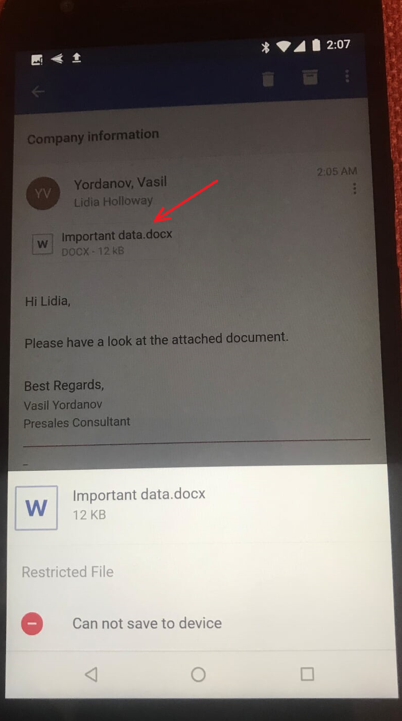
The result: downloads
You can restrict downloading company content to a local storage
You can also restrict opening a certain type of document with an only approved app
Result from an app protection policy (MAM)

Slide 33
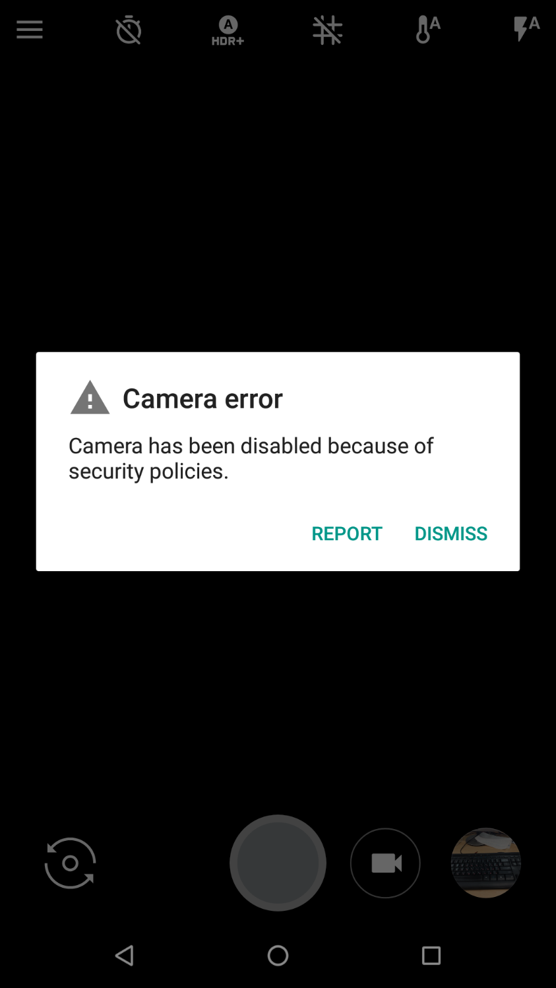
The result: disabled camera
Device camera can be restricted by the organization
Result from device configuration profile (MDM)

Slide 34
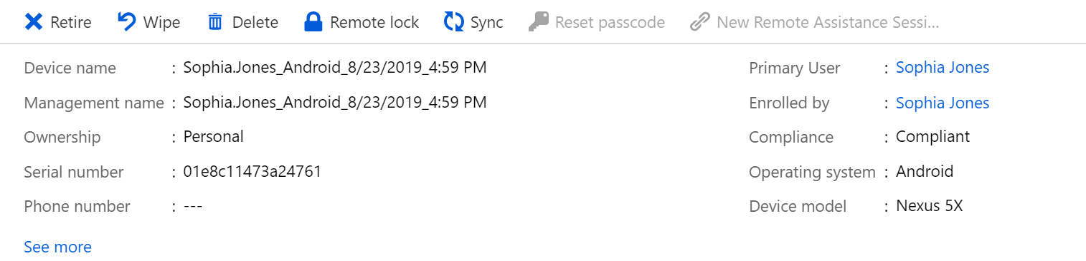
The result: what to do when lost or stolen device
Options to Retire (remove company content) or Wipe (factory reset) lost or stolen device remotely
Result from the MDM enrollment

Slide 35
Questions
sli.do # SaaS-Security

Slide 36
Demonstration

Slide 37

Summary
Security considerations in Exchange Online and SharePoint Online
Office 365 Advanced Threat Protection
Using Microsoft Intune as MDM
Demonstration
…
…
…

Slide 39



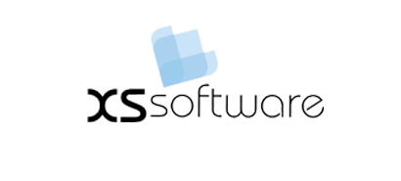


СофтУни диамантени партньори

Slide 40






СофтУни диамантени партньори

Slide 41





Trainings @ Software University (SoftUni)
Software University – High-Quality Education, Profession and Job for Software Developers
softuni.bg
Software University Foundation
http://softuni.foundation/
Software University @ Facebook
facebook.com/SoftwareUniversity
Software University Forums
forum.softuni.bg

